Slide 1

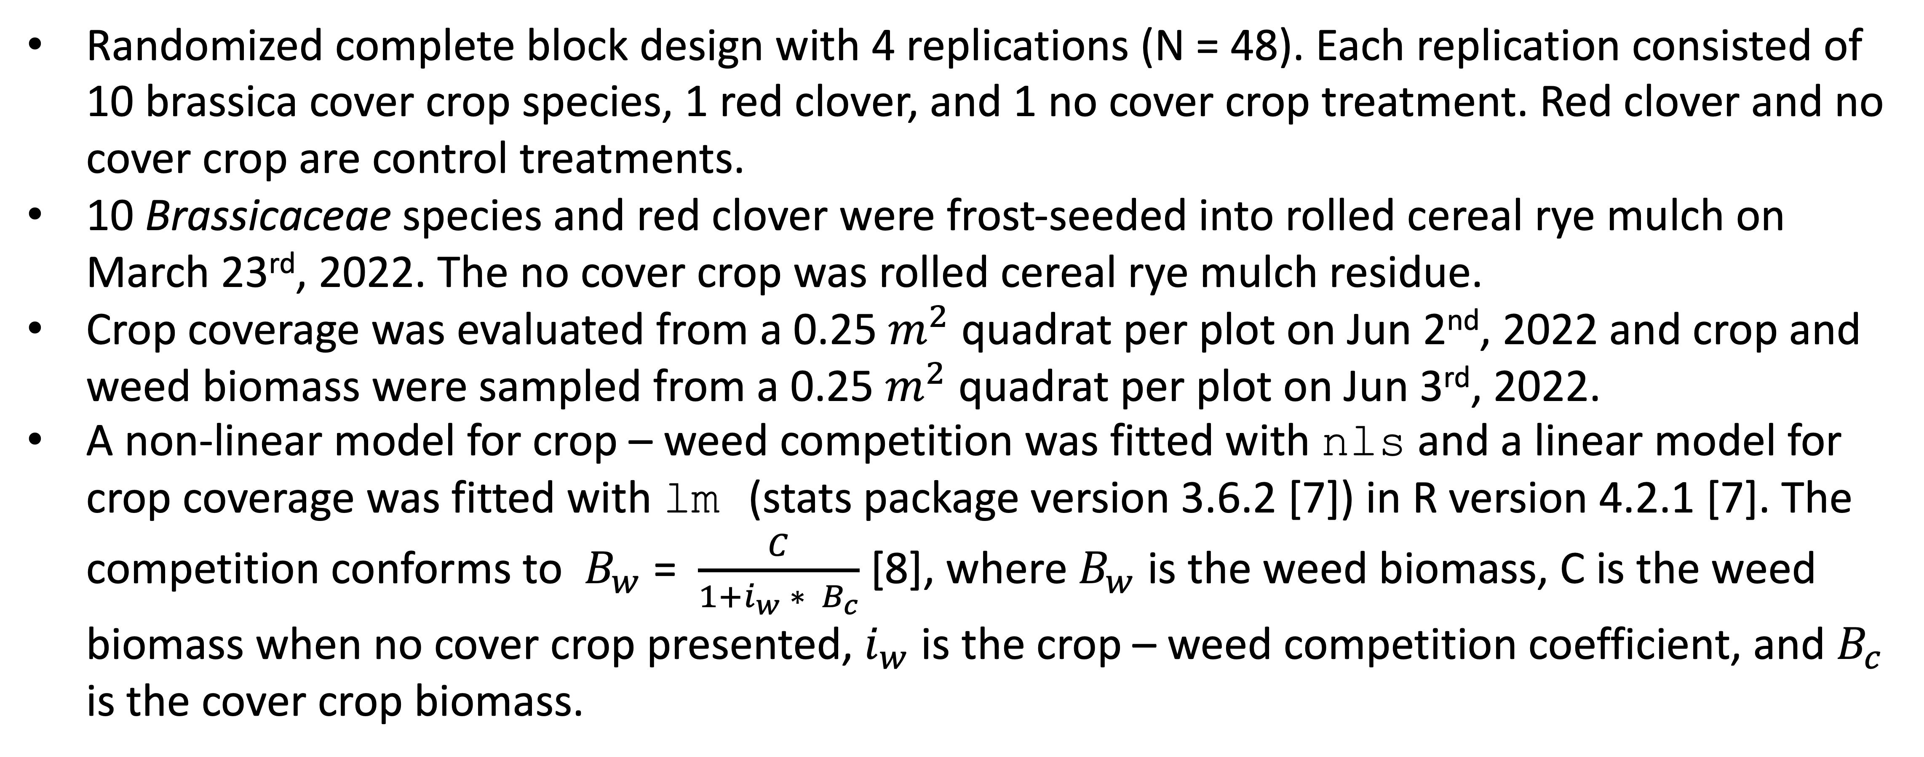
Weed suppression from frost-seeded Brassicaceae cover crops
Huong T. X. Nguyen, Olivia L. Fisher, Amy T. Fox, Kristen Loria, Kathryn F. Marini, Christopher J. Pelzer, Adam N. Sharifi, Domenic D. Varma, Sandra Wayman, Matthew R. Ryan
Motivation
Cover crops can build soil fertility and suppress weeds [1].
Red clover (Trifolium pratense L.) is a winter-hardy cover crop that provides multiple benefits [2] while requires little management [3], but its weed suppression performance is inconsistent [4,5].
Brassicas are cool-season crops. Yellow mustard, spring canola, and winter rapeseed residues when incorporated with soil can reduce weed seedling emergence [6]. Can brassicas provide reliable weed suppression?
Results
Cover crop significantly reduced weed biomass (p = 0.0137). Collard provided the strongest weed suppression among all the examined Brassicaceae species.
Collard’s coverage was significantly higher than that of red clover.
Materials and Methods
References
Randomized complete block design with 4 replications (N = 48). Each replication consisted of 10 brassica cover crop species, 1 red clover, and 1 no cover crop treatment. Red clover and no cover crop are control treatments.
10 Brassicaceae species and red clover were frost-seeded into rolled cereal rye mulch on March 23rd, 2022. The no cover crop was rolled cereal rye mulch residue.
Crop coverage was evaluated from a 0.25 $m^{2}$ quadrat per plot on Jun 2nd, 2022 and crop and weed biomass were sampled from a 0.25 $m^{2}$ quadrat per plot on Jun 3rd, 2022.
A non-linear model for crop – weed competition was fitted with nls and a linear model for crop coverage was fitted with lm (stats package version 3.6.2 [7]) in R version 4.2.1 [7]. The competition conforms to $B_{w}$ = $\frac{C}{1+i_{w} ∗ B_{c}}$ [8], where $B_{w}$ is the weed biomass, C is the weed biomass when no cover crop presented, $i_{w}$ is the crop – weed competition coefficient, and $B_{c}$ is the cover crop biomass.
Teasdale JR. Contribution of cover crops to weed management in sustainable agricultural systems. Journal of production agriculture. 1996 Oct;9(4):475-9.
Ohno T, Doolan K, Zibilske LM, Liebman M, Gallandt ER, Berube C. Phytotoxic effects of red clover amended soils on wild mustard seedling growth. Agriculture, ecosystems & environment. 2000 Apr 1;78(2):187-92.
Duiker SW, Curran SW. Management of red clover as a cover crop. PennState Extension. 2007 Oct.
Mutch DR, Martin TE, Kosola KR. Red clover (Trifolium pratense) suppression of common ragweed (Ambrosia artemisiifolia) in winter wheat (Triticum aestivum). Weed Technology. 2003 Mar;17(1):181-5.
Bryan CJ, Sipes SD, Arduser M, Kassim L, Gibson DJ, Scott DA, Gage KL. Efficacy of cover crops for pollinator habitat provision and weed suppression. Environmental Entomology. 2021 Feb;50(1):208-21.
Haramoto ER, Gallandt ER. Brassica cover cropping for weed management: A review. Renewable agriculture and food systems. 2004 Dec;19(4):187-98.
R Core Team (2022). R: A language and environment for statistical computing. R Foundation for Statistical Computing, Vienna, Austria. URL: https://www.R-project.org/.
Spitters CJ. An alternative approach to the analysis of mixed cropping experiments. 1. Estimation of competition effects. Netherlands Journal of Agricultural Science. 1983 Feb 1;31(1):1-1
Acknowledgements Keith Berns, Green Cover Seed, Bladen, Nebraska
This work was funded by USDA NIFA Organic Agriculture Research and Extension Initiative and New York State Department of Agriculture and Markets.

